Slide 1
UFCW Local 1500
Welfare Fund
Associated Administrators, LLC
Report
MARCH 11, 2014
Bill Jensen / President
Curtis Bryan, CIC, CRM / Account Executive
Emily Novak / Account Executive

Slide 2
Agenda
AMR Highlights 4th Quarter 2013
JAA Status Update
  Snapshot
  High Value Claim
Appeals
  Appeals Subcommittee
  Tabled Claims
Other Fund Business
  Claims Report
  GVS report (updated request)
  ACA and Bargained Changes
Conclusion

Slide 3

AMR/Highlights: 4Q13 Summary
Full Time Plan
  Deficit continues during 4Q13
      Total Medical expense in 4Q13 was $9.6 million
        $12.3 / $10.4 / $11.3 / $9.9 million in previous four quarters
      Total Rx cost in 4Q13 was $2.4 million
        $1.7 / $2.1 / $2.3 / $2.1 million in previous four quarters
      Overall expense for 4Q13 was $13.0 million
      (3Q13 - $12.9 million / 4Q12 - $14.9 million)
      4Q13 deficit was $1.5 million; YTD deficit was $9.2 million
  PPPM Cost 4Q13 - $1,091 ; YTD - $1,136
  The predominant contribution rate effective June 1, 2012 is $960

Slide 4

AMR/Highlights: 4Q13 Summary
Part Time Plan
  Surplus continues
    4Q13 Surplus - $1.4 million; YTD Surplus - $4.9 million
  Overall expense for 4Q13 was $1.3 million
  (3Q13 - $1.4 million / 4Q12 - $1.2 million)
  PPPM Cost 4Q13 - $34; YTD - $36
  The predominant contribution rate effective June 1, 2012 is $66.43

Slide 5

AMR/Highlights: 4Q13 Summary
Special Part Time Plan
  Surplus of $0.01 million for 4Q13
  Total expense for 4Q13 was $1.4 million
  (3Q13 - $1.7 million / 4Q12 - $1.6 million)
  PPPM Cost 4Q13 - $269; YTD - $279
  The predominant contribution rate effective June 1, 2012 is $272.57

Slide 6

AMR/Highlights: 4Q13 Summary
Combined Plans
  Smaller Deficit in Full Time Drove an Overall Surplus for All Combined Plans
      4Q13 Surplus - $0.4 million; YTD - $3.3 million deficit
  PPPM Cost 4Q13 - $281; YTD - $294
  Recap of 4Q13:
    FT – 4Q13 $1.5 million deficit; YTD $9.2 million deficit
    PT – 4Q13 $1.4 million surplus; YTD $4.9 million surplus
    SPT – 4Q13 $0.01 million surplus; YTD $0.4 million deficit
    All Plans – 4Q13 $0.4 million surplus; YTD $3.3 million deficit
    (includes investment and other income)

Slide 7

AMR/Highlights: 4Q13 Summary
Reserve Projection
  As of December 31, 2013 – 1.9 months
        Future projections
          3 months out (3/31/14): 1.6 months
          6 months out (6/30/14): 1.4 months
          12 months out (12/31/14): 0.9 months
  NOTE: Reserve is based on unassigned reserve only.

Slide 8
JAA Status Update
Snapshot
Month | Claims Processed | Billed Amount | Paid Amount
June | 2,456 | 238,367 | 84,016
July | 7,203 | 1,618,099 | 582,810
August | 7,193 | 6,779,387 | 1,404,414
September | 7,821 | 10,457,587 | 3,402,673
October | 12,541 | 12,550,001 | 4,133,446
November | 10,138 | 8,941,098 | 2,929,027
December | 8,523 | 7,818,525 | 2,430,267
Totals | 55,875 | 48,403,064 | 14,966,653

Slide 9
JAA Status Update cont’d
High Value Claim –Full Time Plan
  Original Amount: $39,878.59 which we paid
  Provider re-billed with additional charges. New total was: $51,517.99
    Anthem DRG Allowed Amount was: $1,232,518.71
  We pended claim for review:
    Referred to Anthem for clarification on the pricing.
    Status: Claim withdrawn and resubmitted with corrected DRG code. Corrected price: $50,584.37

Slide 10
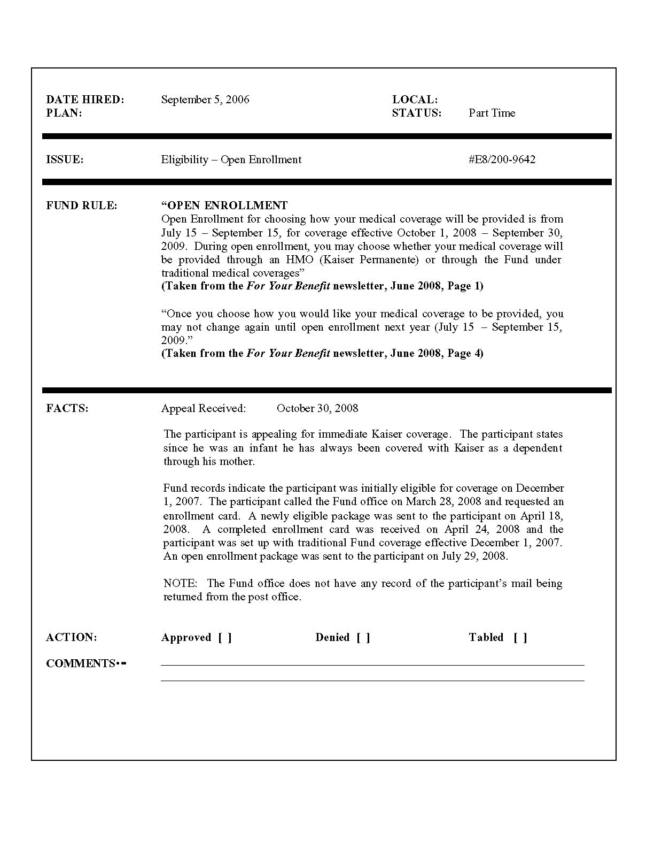
Appeals
Appeals

Slide 11
Appeals
Appeals Subcommittee
  Bruce Both Anthony Speelman
  Richard Grobman Mike Grosso
  4 approved, 9 denied, 2 tabled
Tabled Appeals
  M13/176-4144 - Emergency Treatment
  M14/102-8957 - Excluded Services

Slide 12
Claims Report

Slide 13
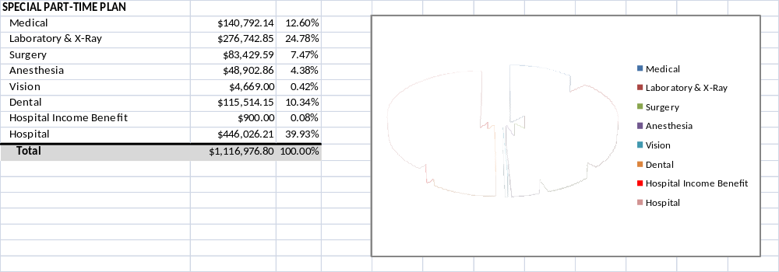
Claims Report, cont’d

Slide 14
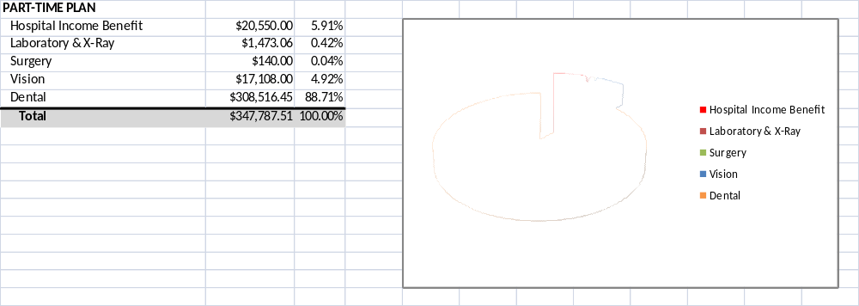
Claims Report, cont’d

Slide 15

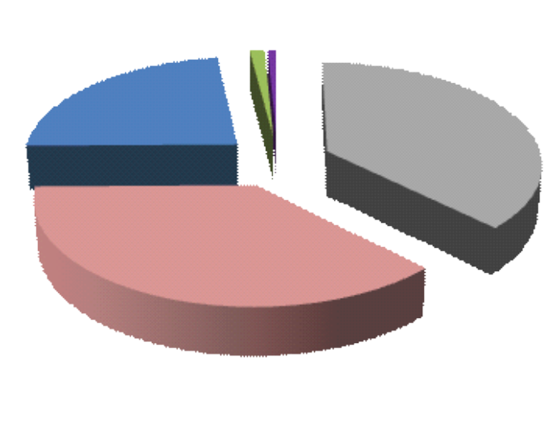
Claims Report, cont’d
Retiree Plan
Death Benefit
$26,000.01
37.53%
Hospital
$25,826.77
37.28%
Medical
$16,030.08
23.14%
Surgery
$886.29
1.28%
Anesthesia
$529.46
0.76%
Death Benefit
Total
$69,272.61
100.00%
Hospital
Medical
Surgery
Anesthesia
Total for 4th Quarter
$12,057,845.78

Slide 16
Claims New Report, cont’d
Top 10 Diagnosis Groups
Amount Paid
Disease
$1,313,595.09
Cancer
$876,756.91
Aneurysm
$819,137.07
Heart Disease
$777,995.41
Cerebral Vascular Disease
$648,499.87
Hemodialysis
$398,099.57
Renal
$176,708.34
Shock
$176,295.11
Septicemia
$132,279.78
Diabetic Amputation
$119,202.31
Lupus
Full Time Participants Approaching $2 million Annual Max
Participant
Relationship
Amt Paid
Amt Remaining
1
Dependent
$648,499.87
$1,351,500.13
2
Spouse
$534,187.50
$1,465,812.50
2
Dependent
$389,309.04
$1,610,690.96
4
Participant
$312,779.34
$1,687,220.66
5
Dependent
$288,034.75
$1,711,965.25

Slide 17
Other Fund Business
GVS – Vendor Report Request (Previously Approved)
  Additional Request – that member dates of birth be included be prevent mistaken identity.

Slide 18
Other Fund Business
ACA and Bargained benefit changes completed.
9 Area Meetings to Address Medical Plan Changes
  AA, Aria and Segal assisted in the meeting presentations
COBRA Letters Updated with 1/1/14 ACA Changes
Positive Pay

Slide 19
Conclusion
Thank You
Questions?

